Slide 1
Battle of the Neighbourhoods
Capstone Project

Slide 2
The battle of the Neighbourhoods
This project covers the analysis of location data for both New York city and Toronto
Foursquare API is used to identify venues common to both cities
Analysis is completed to help in determine the best city in which to locate to for a new job, based on venue data

Slide 3
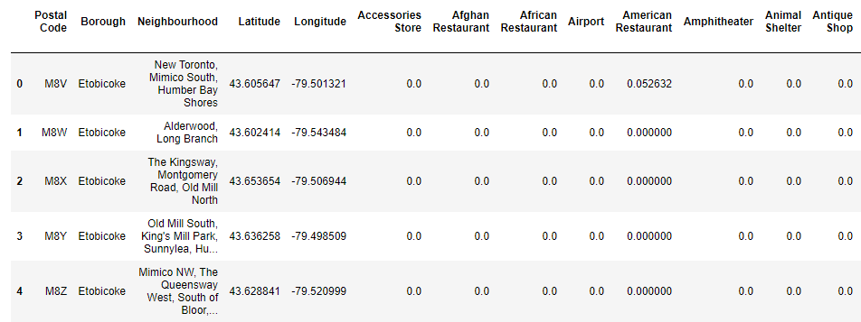
The battle of the Neighbourhoods
Sample data for Toronto shows a few of the venue data included in the analysis
The same venue categories are used for New York in order to determine the ‘commonality’ of venues across the cities

Slide 4
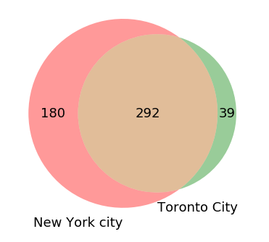
Common Venues
292 venues are common across both Toronto and New York
New York has 180 ‘unique’ venues (ie venues not found in Toronto)
Toronto has 39 ‘unique’ venues

Slide 5
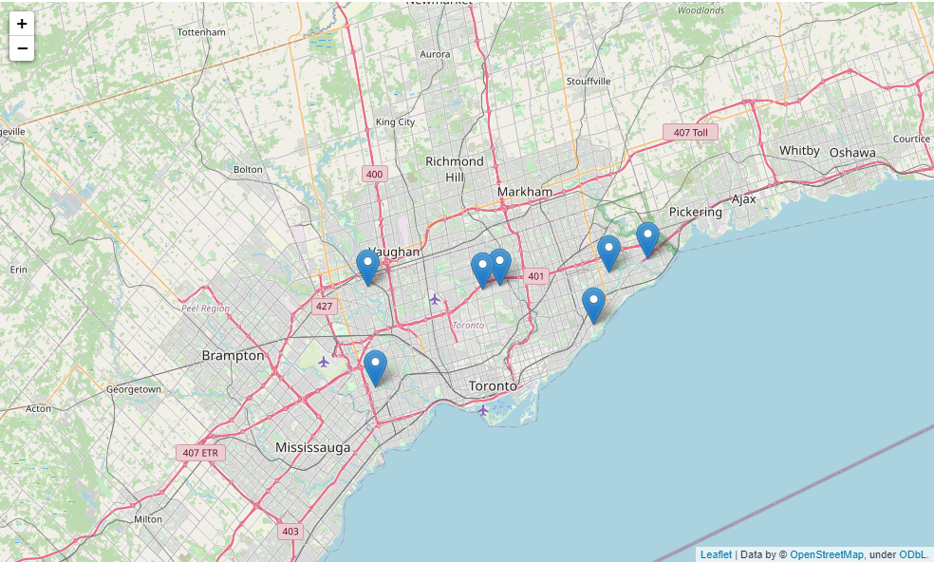
Neighbourhood locations
Toronto venues are spread out across the city, with the closest neighbours located in the New York neighbourhood of Toronto
Commuting across the city could be an issue for a new resident

Slide 6
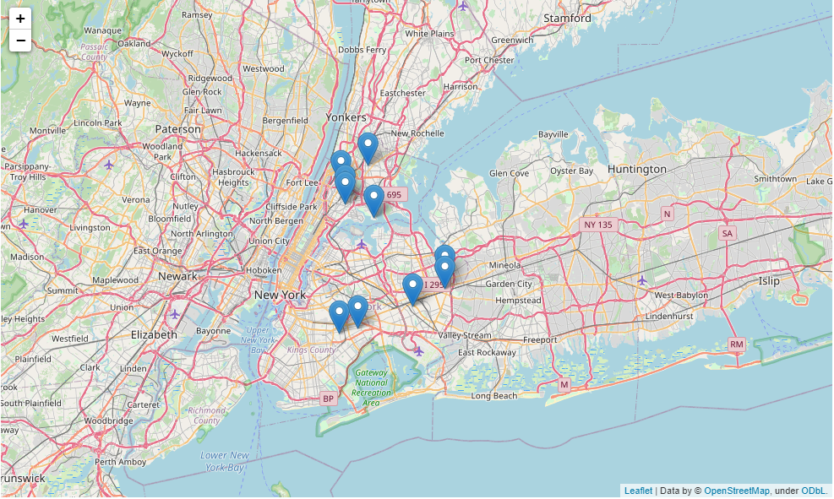
Neighbourhood locations
The Bronx in New York contains several selected venues
These are closely located and travel is minimal
New York transit is potentially better than Toronto

Slide 7
Conclusion
For convenience and accessibility New York, specifically the Bronx appears to be the better option
There are more unique venues in New York providing the option to expand on tastes and identify new venues that may become new favourites
Most of the venues identified in New York are located centrally around La Guardia airport, making it easier to access them when family visit from out of town

